Slide 1

10 Awesome Things You Can Build with NativeScript
TJ VanToll | @tjvantoll

Slide 2

Boom

Slide 3
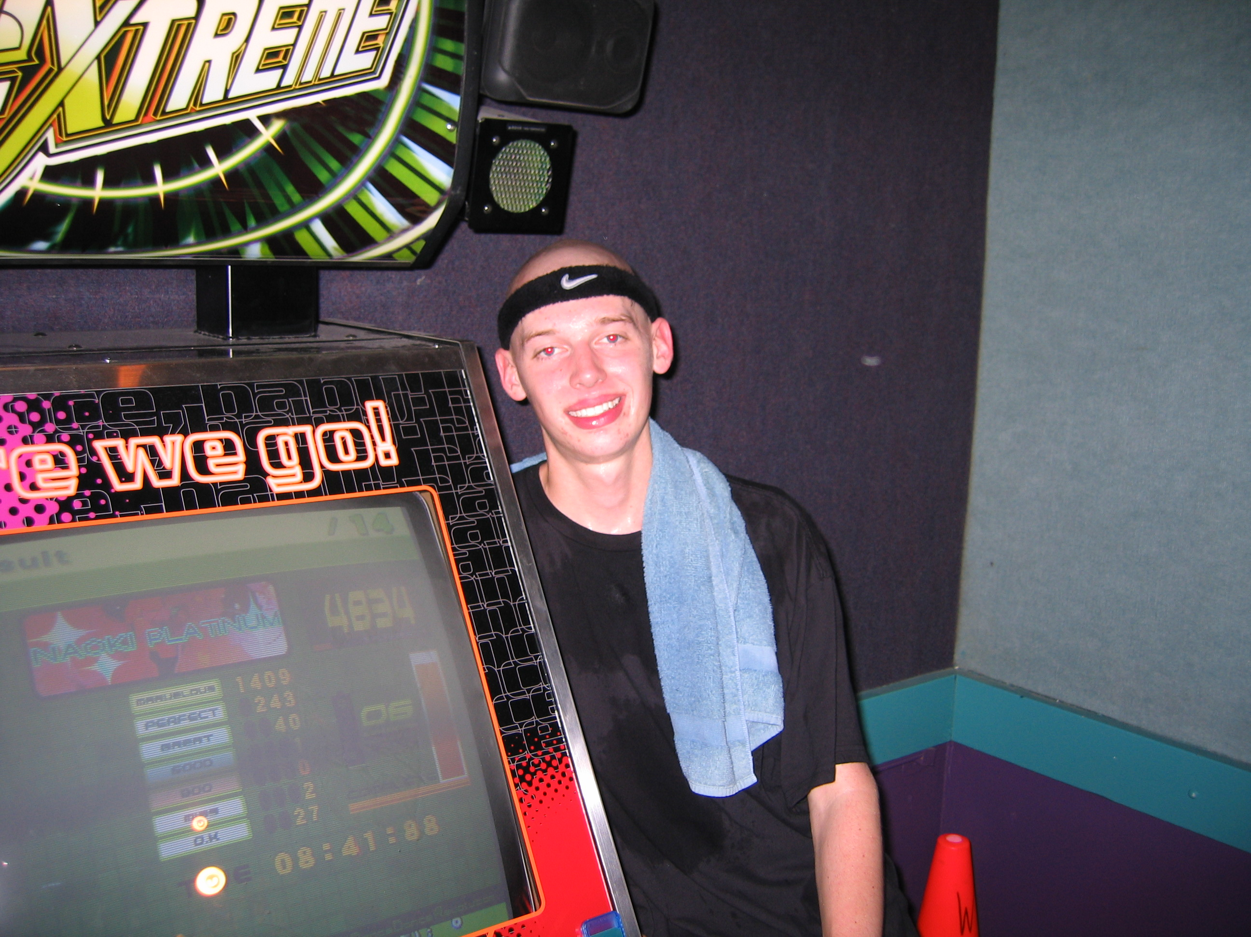
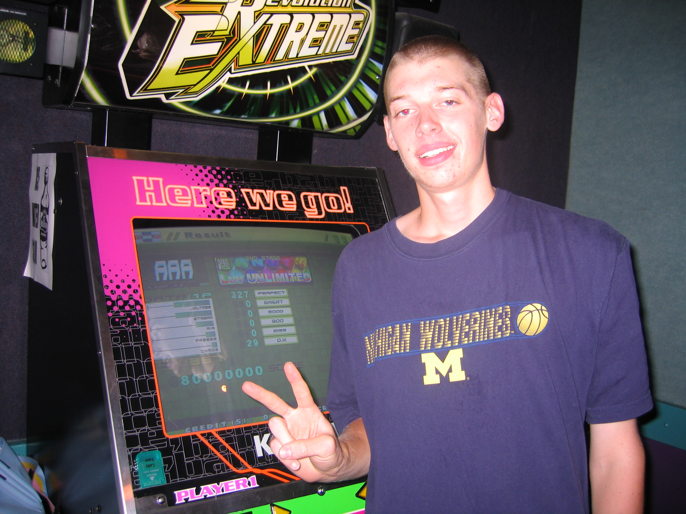



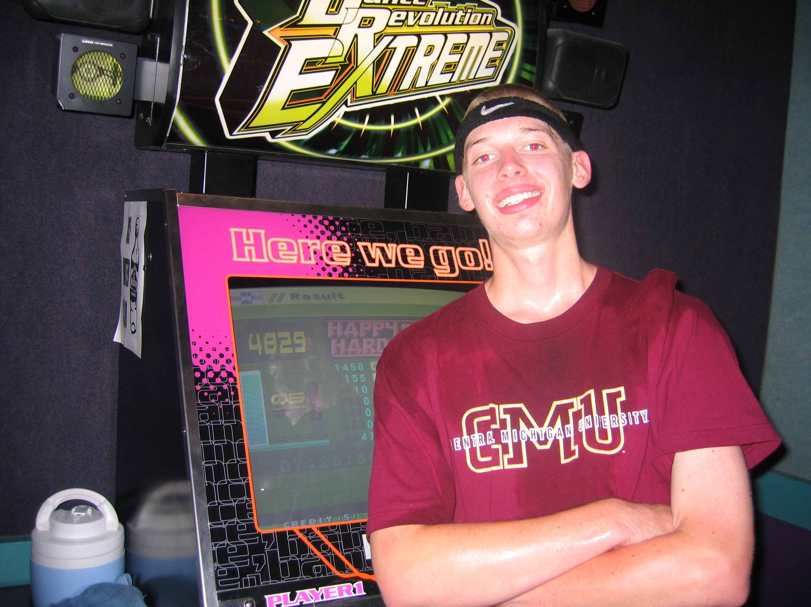
🏆
🏆
🏆
🏆
🏆
🏆
🏆

Slide 4
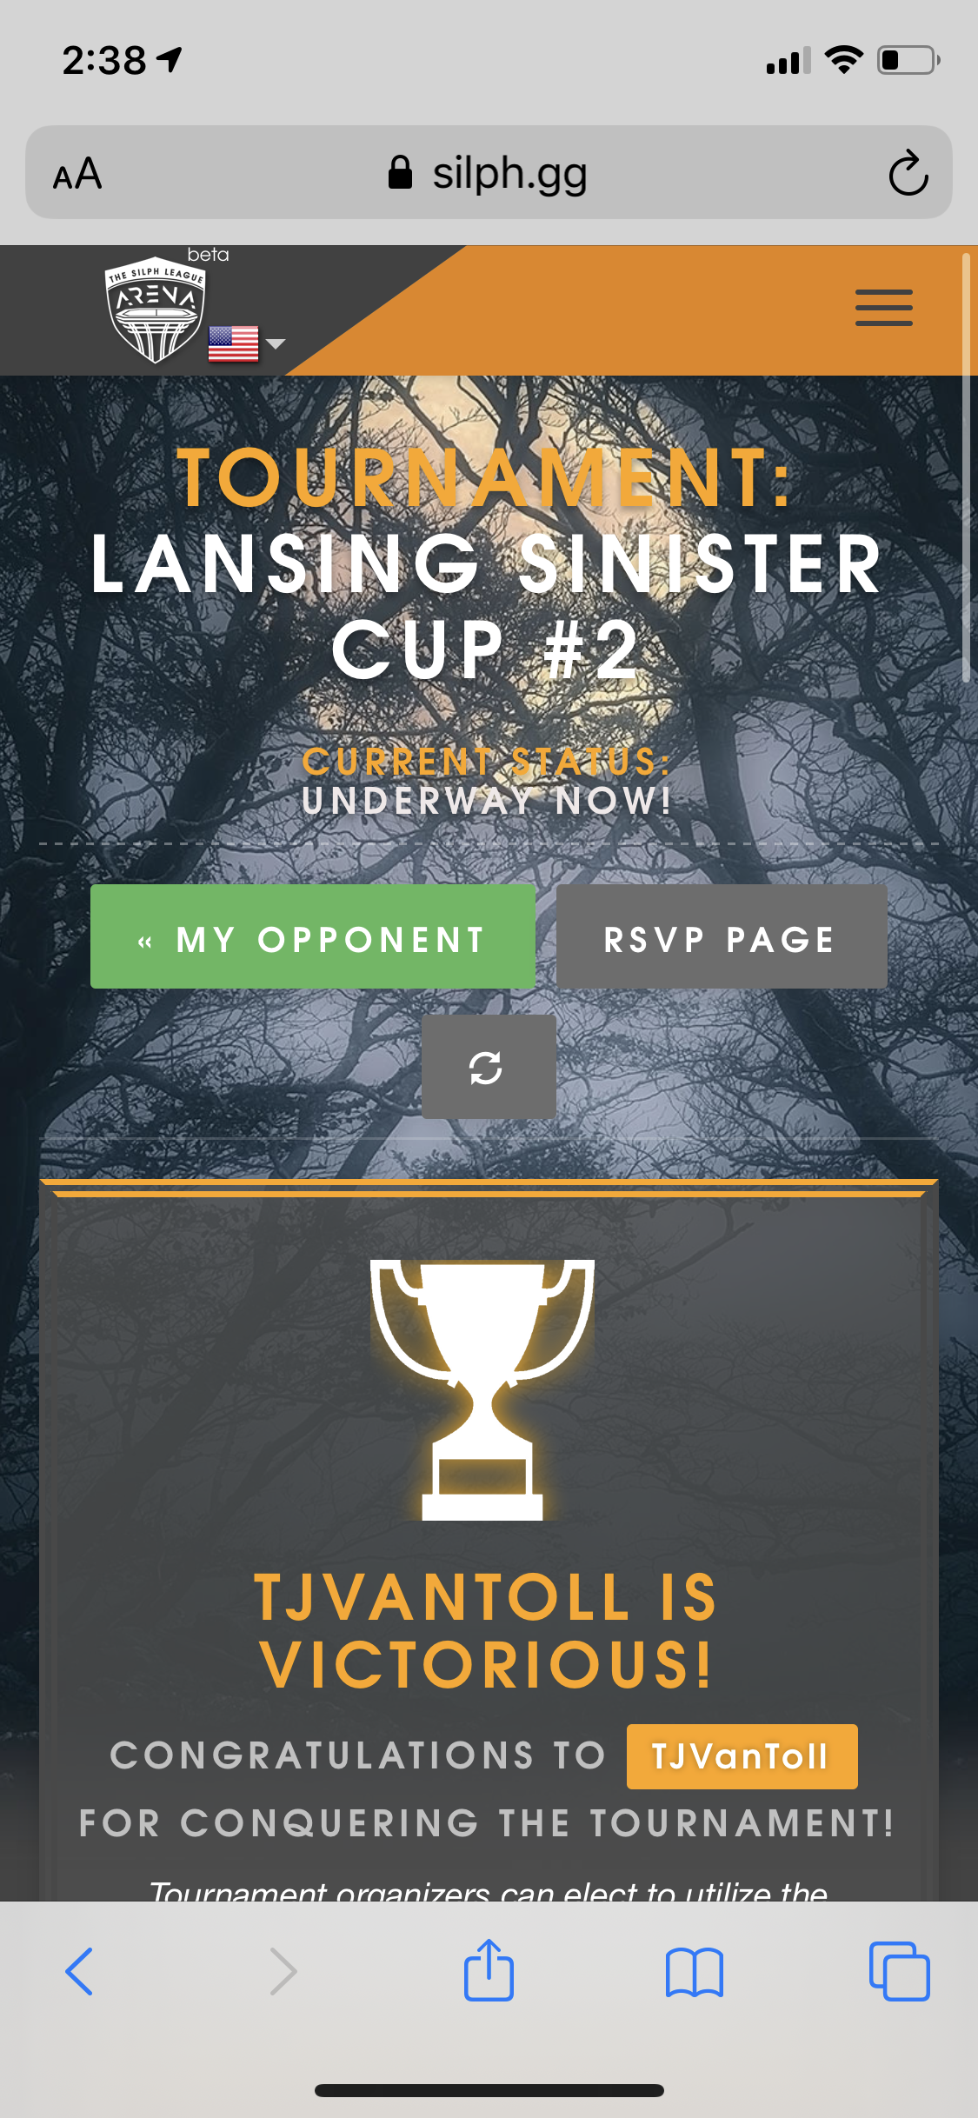
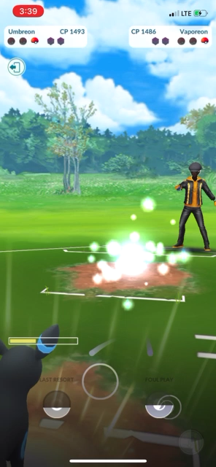

Slide 5
listicle
a piece of writing or other content presented wholly or partly in the form of a list.
Notes:
trend

Slide 6
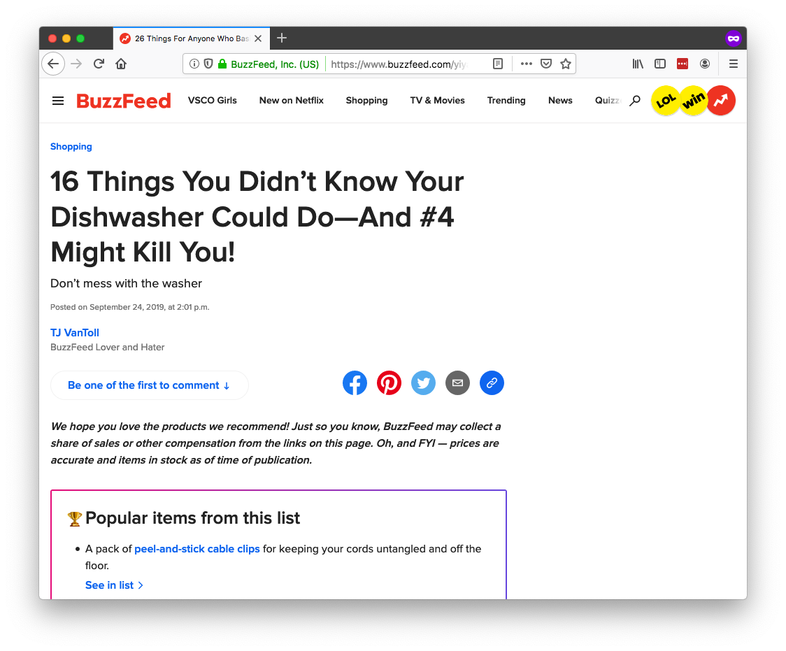

Slide 7
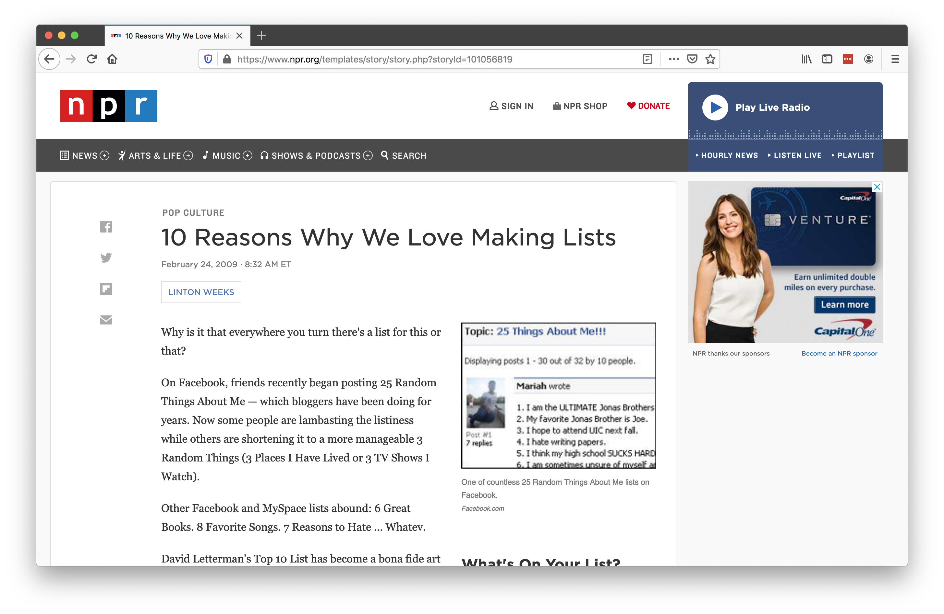

Slide 8
10 Awesome Things You Can Build With NativeScript

Slide 9
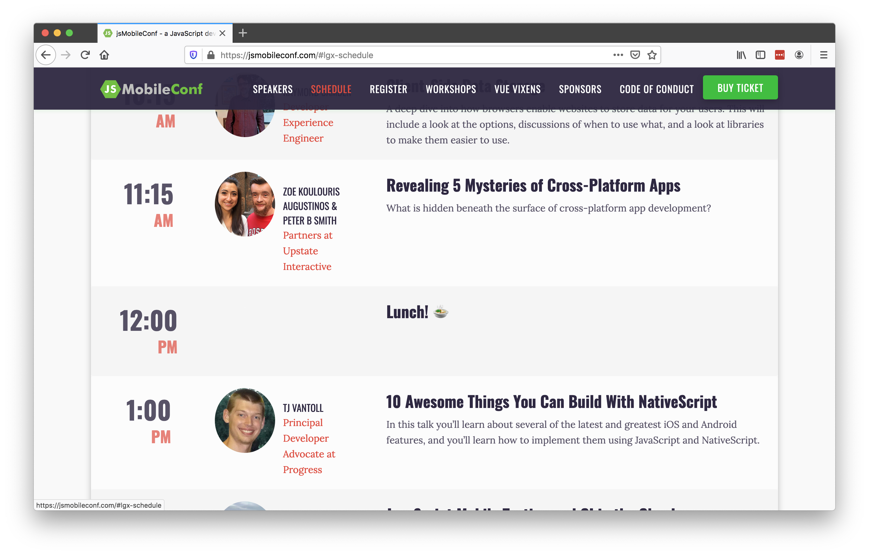

Slide 10
10 Awesome Things You Can Build With NativeScript

Slide 11
💡

Slide 12
📖

Slide 13
Slides: https://bit.ly/top10-slides
Demo: https://bit.ly/top10-demo

Slide 15
NativeScript 101
Build cross-platform iOS & Android apps
Build with JavaScript
CSS for app styling
Optionally use TypeScript
Optionally use JS frameworks like Angular and Vue.js
Free and open source
Makes it easy to build native UI and use native APIs

Slide 16
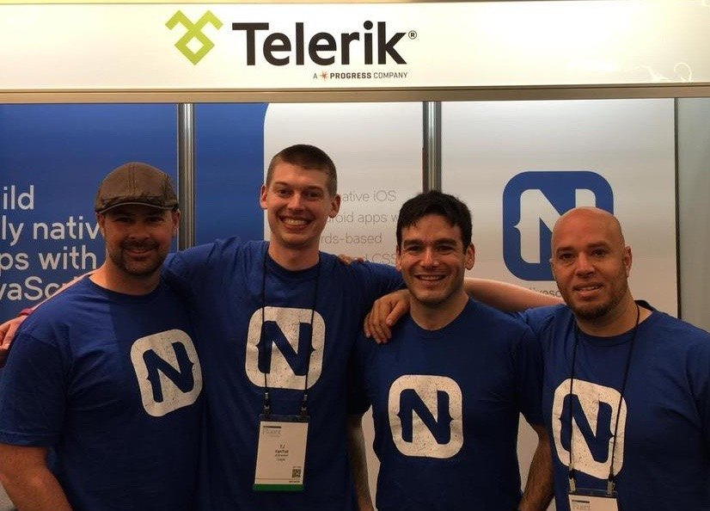


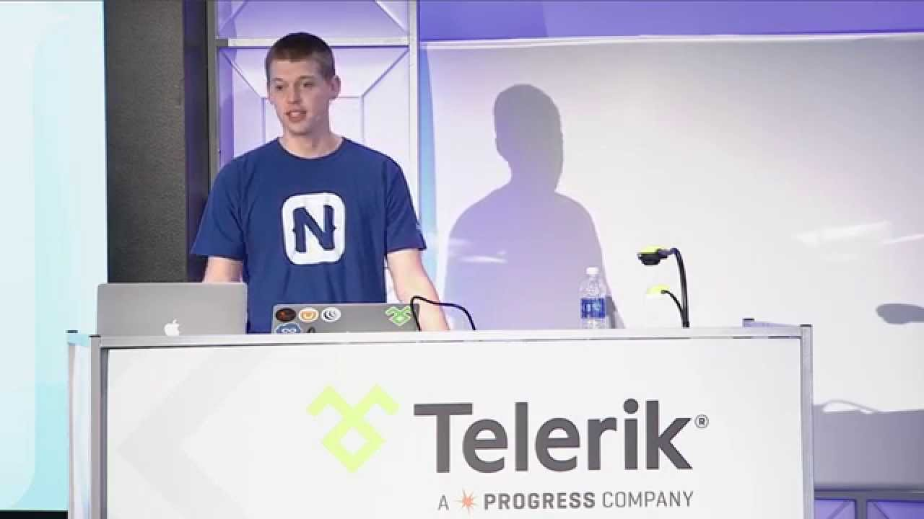

Slide 17
Agenda
Pragmatic
Biometric Auth, Maps & Geolocation, Code Sharing, Animations
Useful
AppSync, Bluetooth, Wearables, Native API access
Fun
Machine Learning, AR

Slide 18
Agenda
Pragmatic
Biometric Auth, Maps & Geolocation, Code Sharing, Animations
Useful
AppSync, Bluetooth, Wearables, Native API access
Fun
Machine Learning, AR

Slide 19
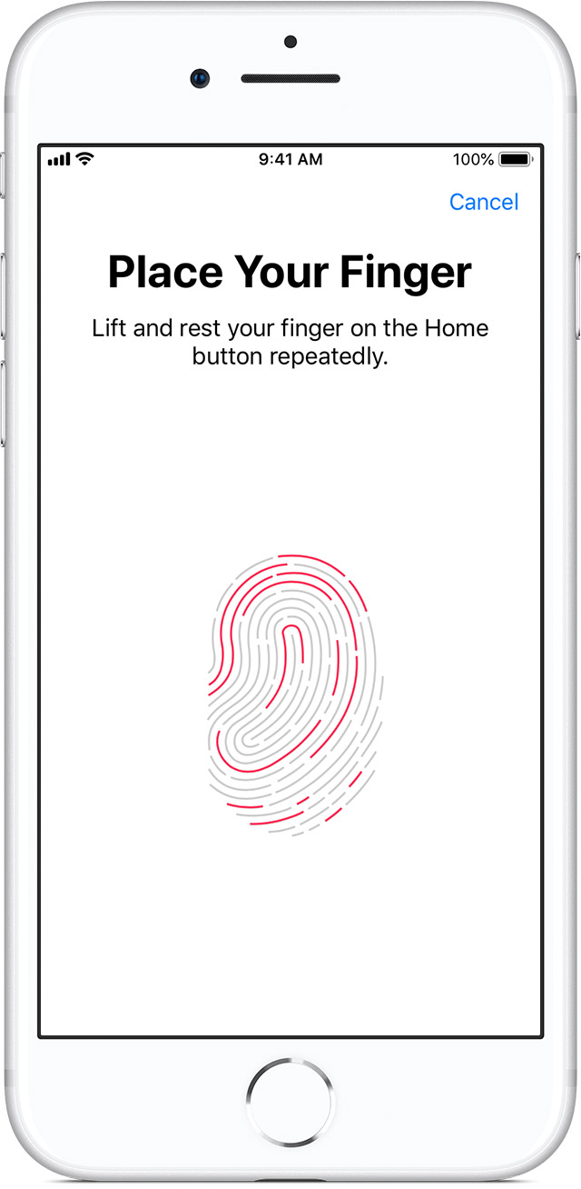
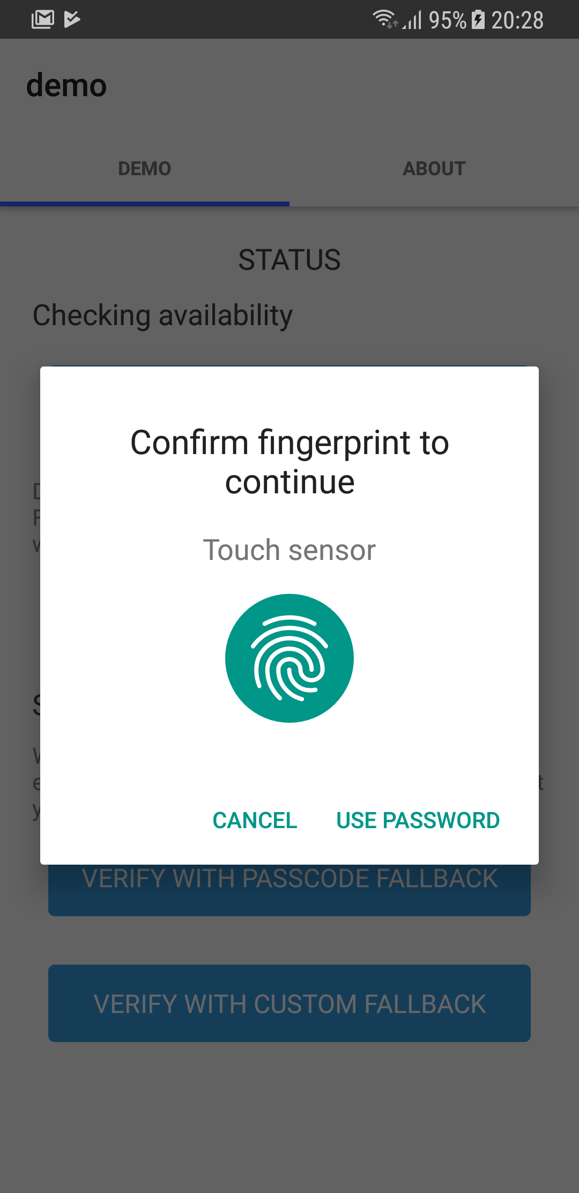
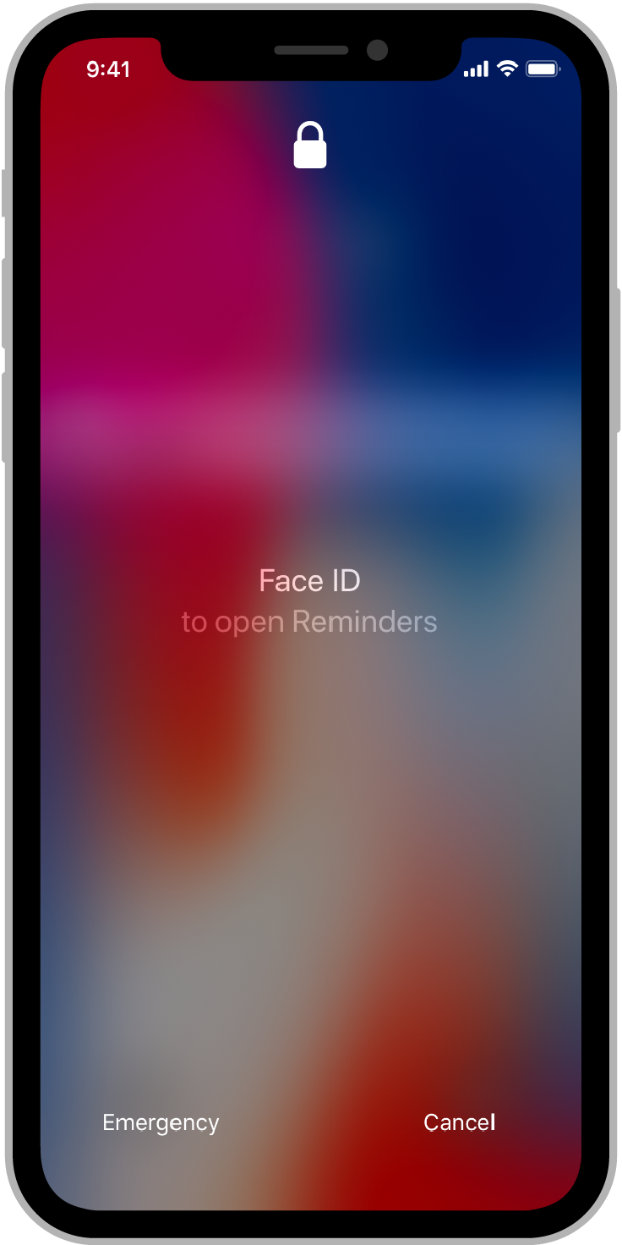
#1: Biometric auth

Slide 20
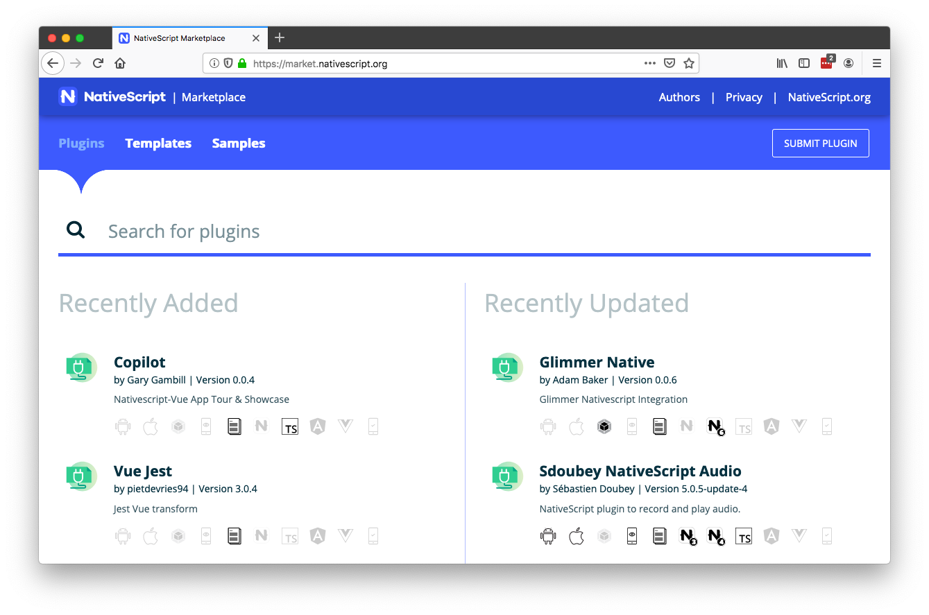

Slide 21
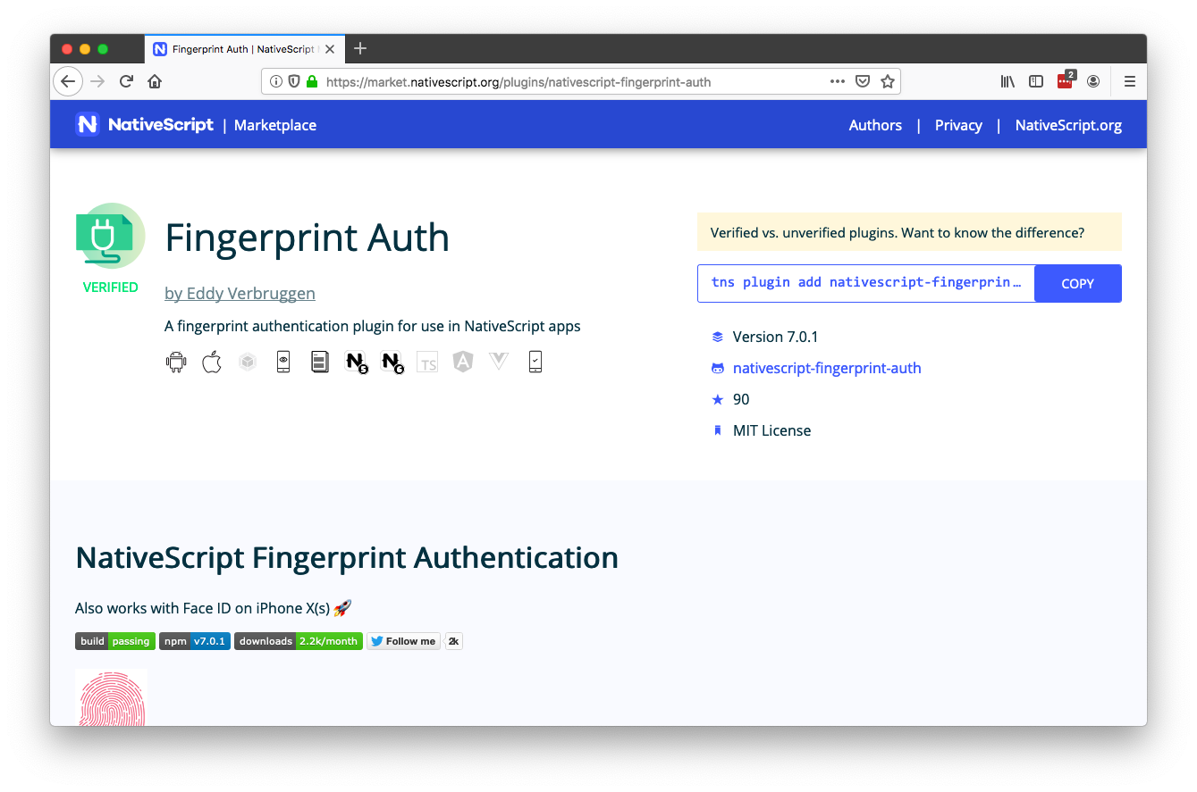

Slide 22
Biometric auth resources
Plugin: https://github.com/EddyVerbruggen/nativescript-fingerprint-auth
Article: https://www.progress.com/blogs/implementing-a-mobile-biometric-authentication-system-for-enterprise-applications

Slide 23
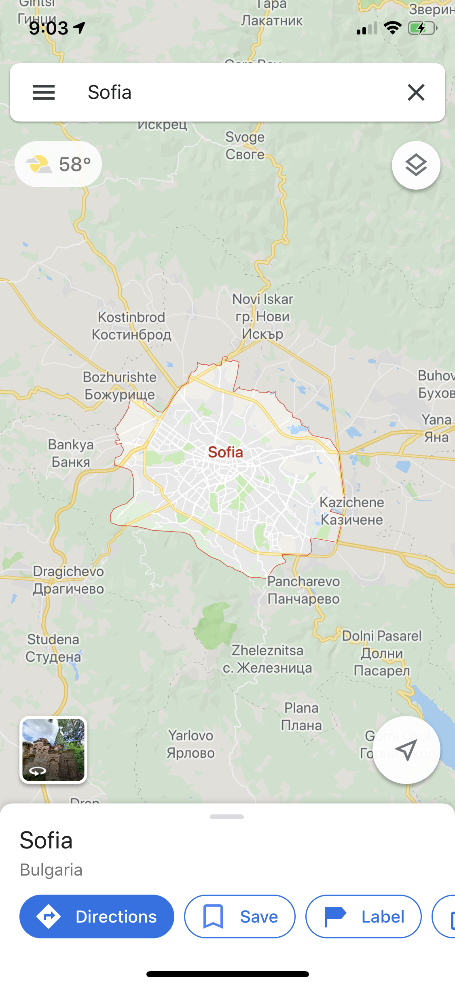
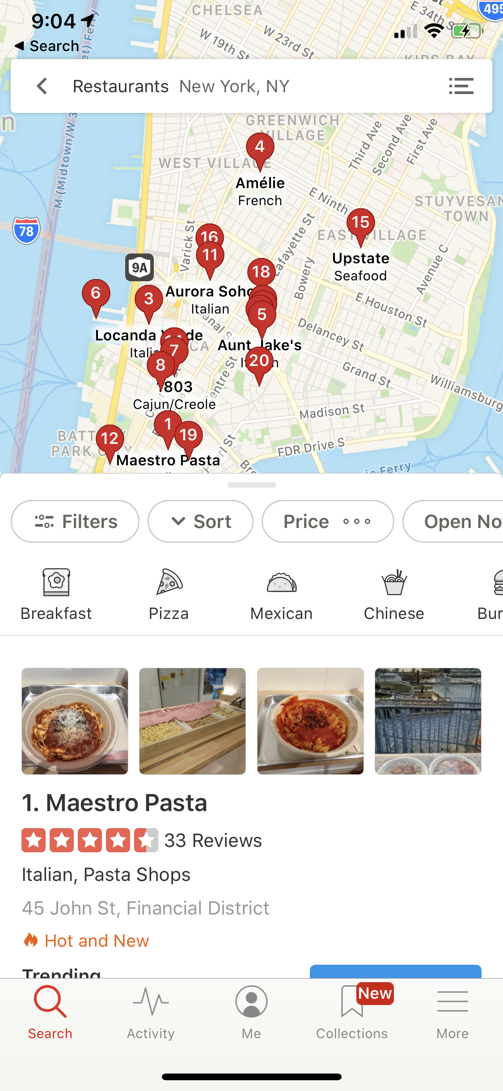
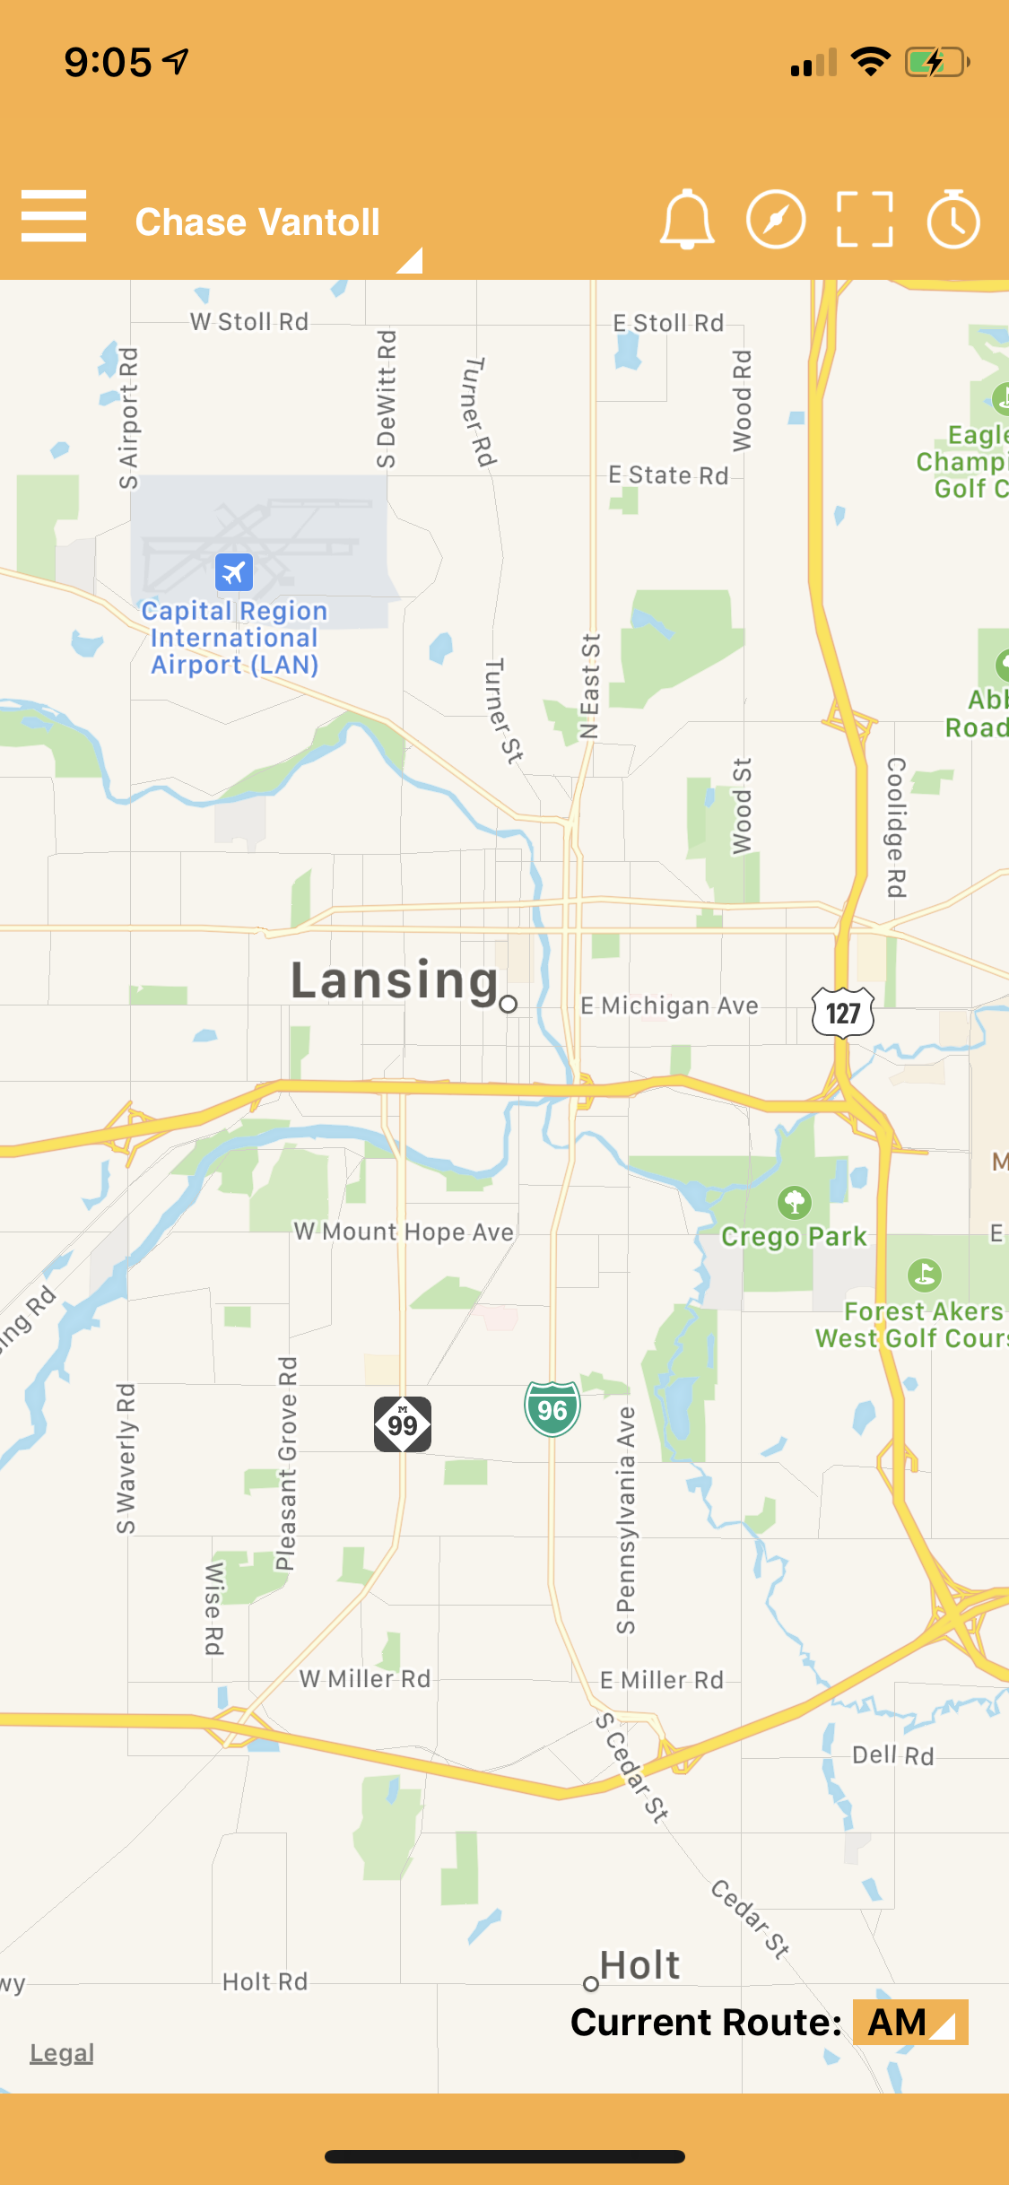
#2: Maps & geolocation

Slide 24
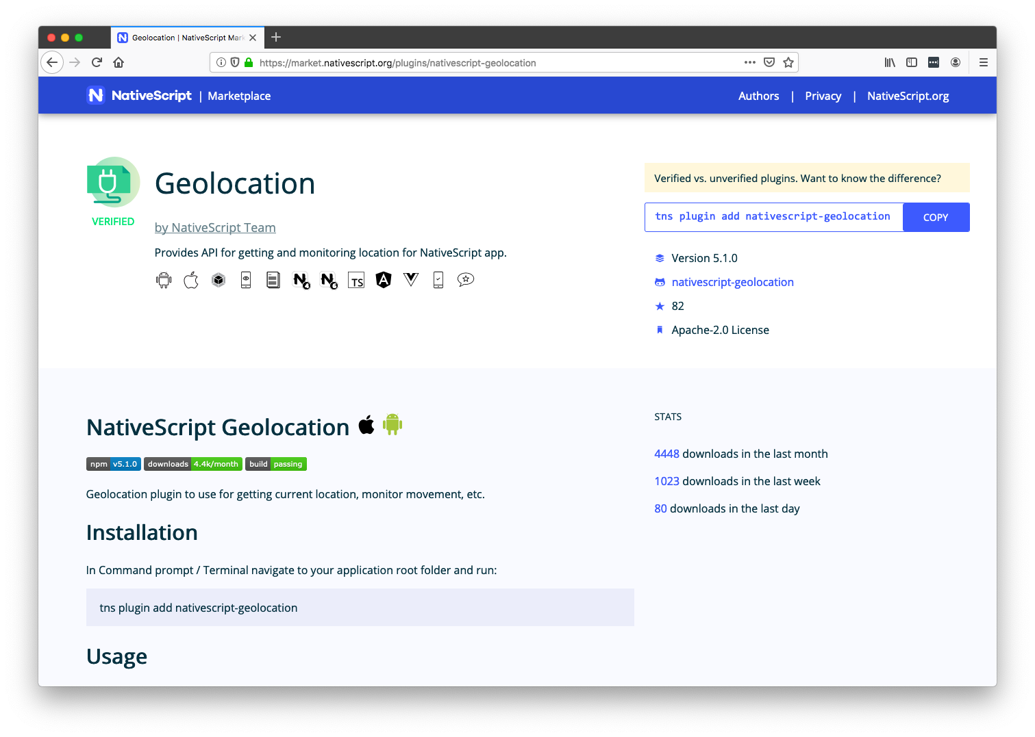

Slide 25
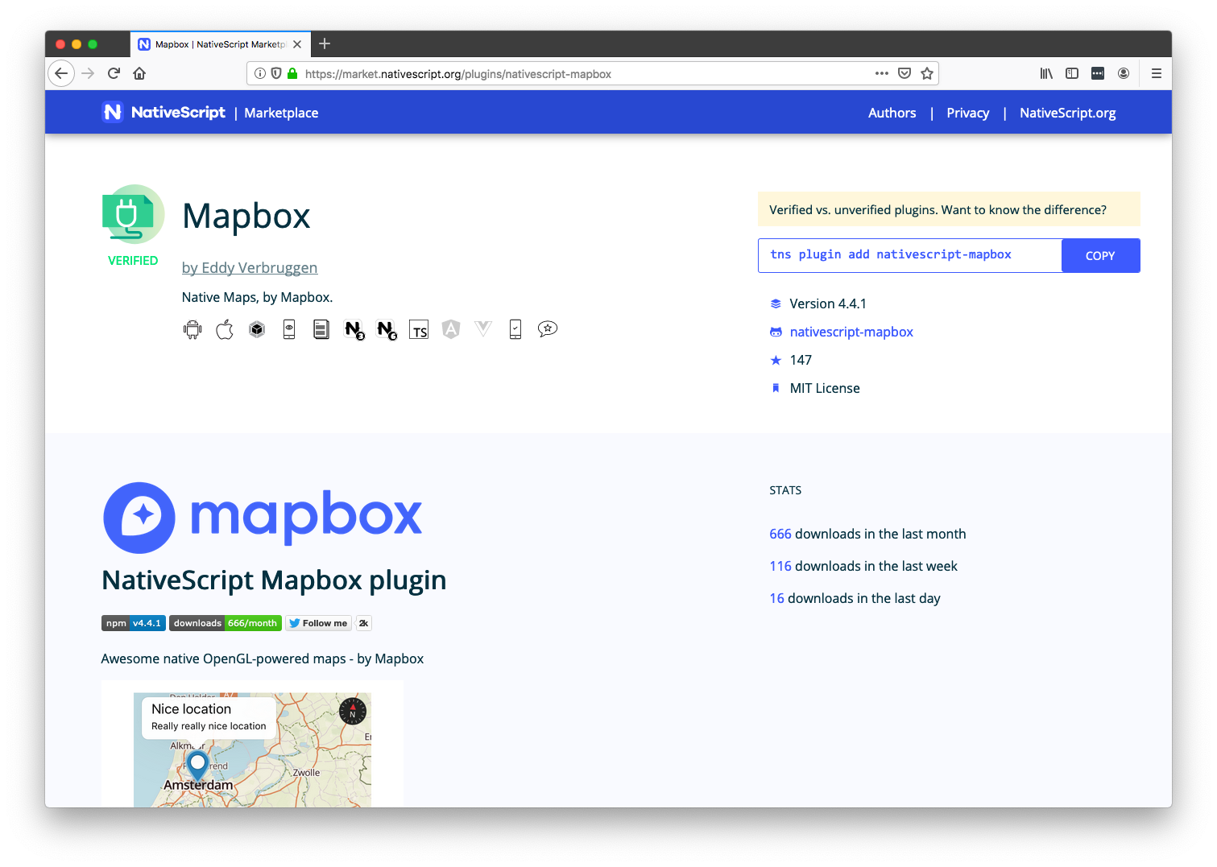

Slide 26
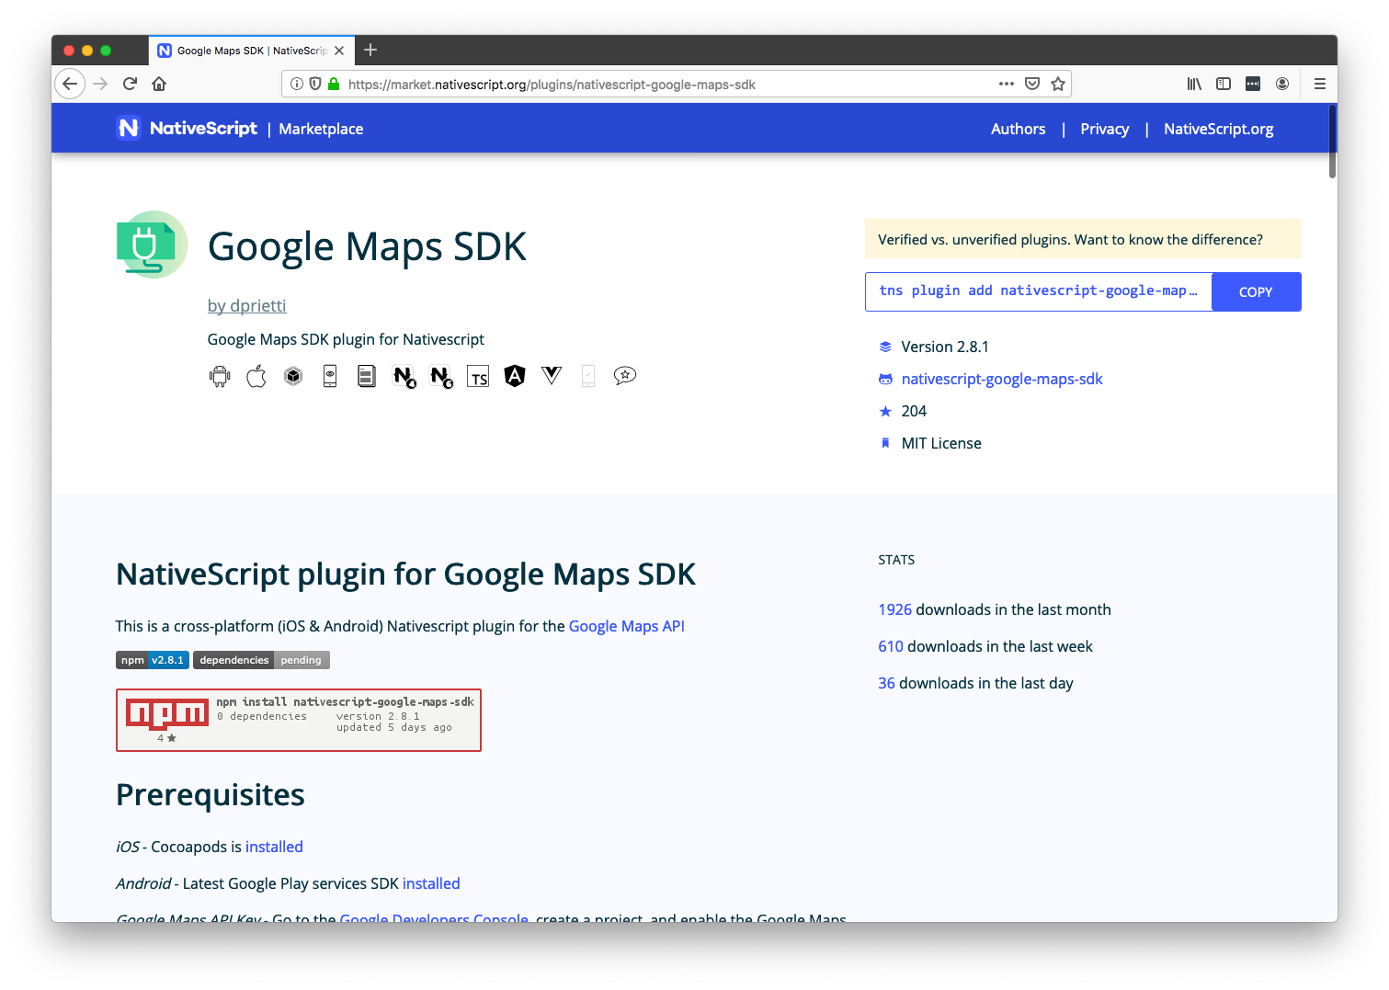

Slide 27
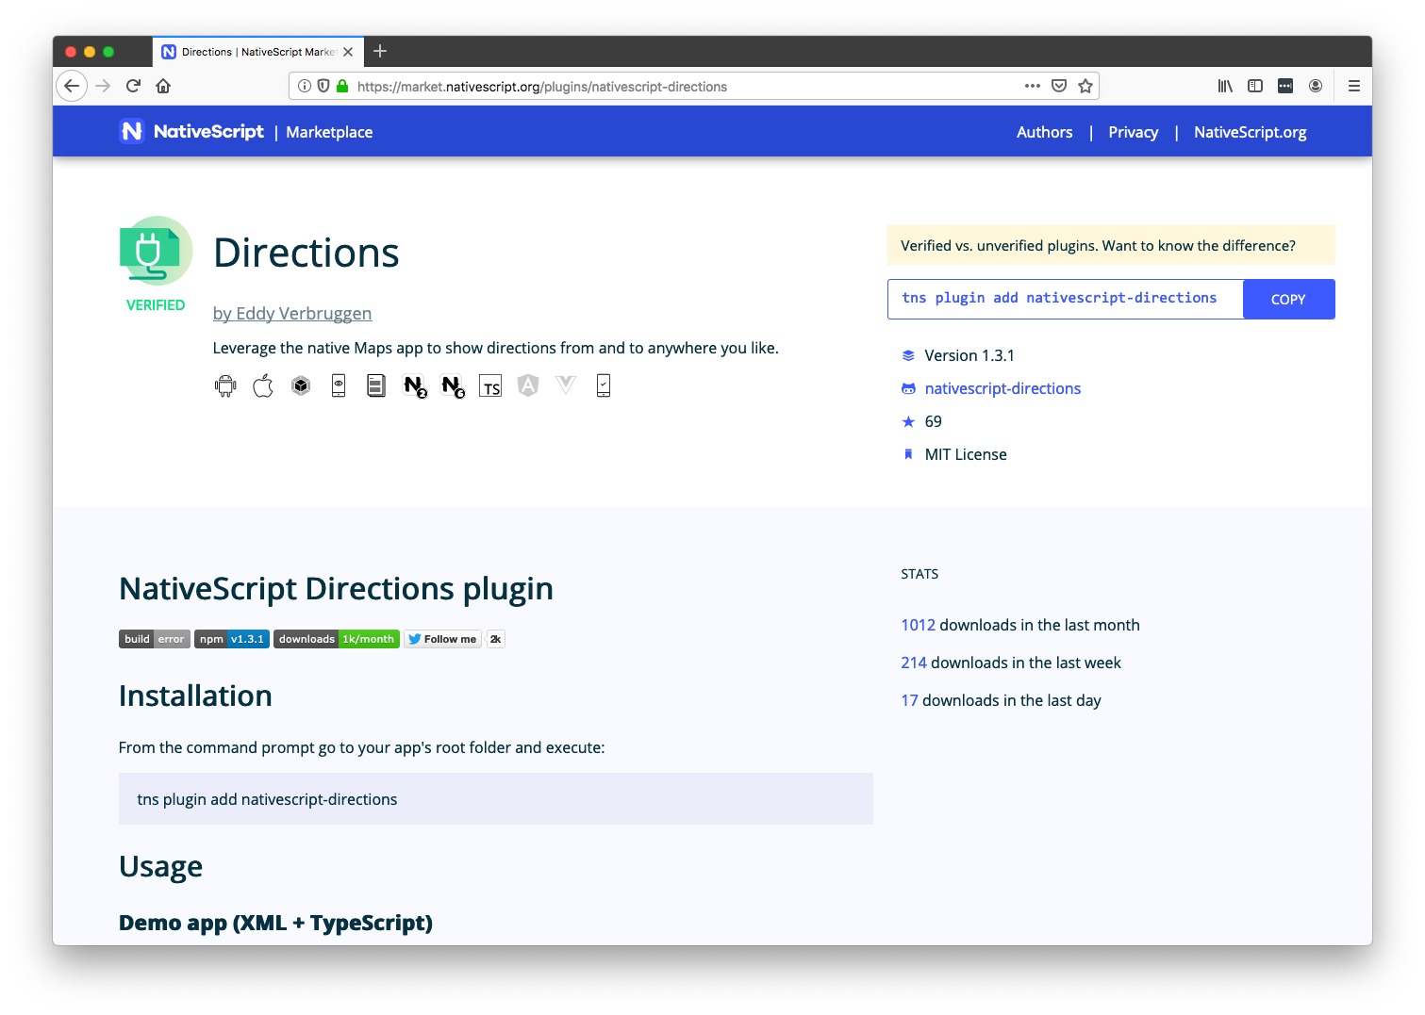

Slide 28
Maps & geolocation resources
https://market.nativescript.org/plugins/nativescript-geolocation
https://market.nativescript.org/plugins/nativescript-mapbox
https://market.nativescript.org/plugins/nativescript-google-maps-sdk
https://market.nativescript.org/plugins/nativescript-directions

Slide 29
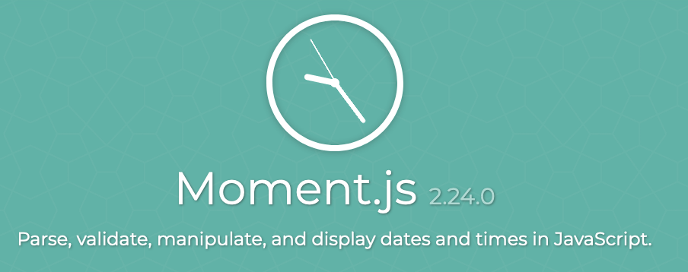



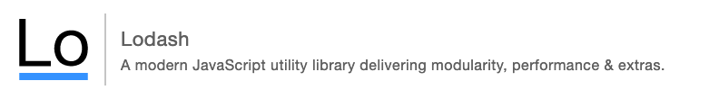
#3: Code sharing

Slide 30
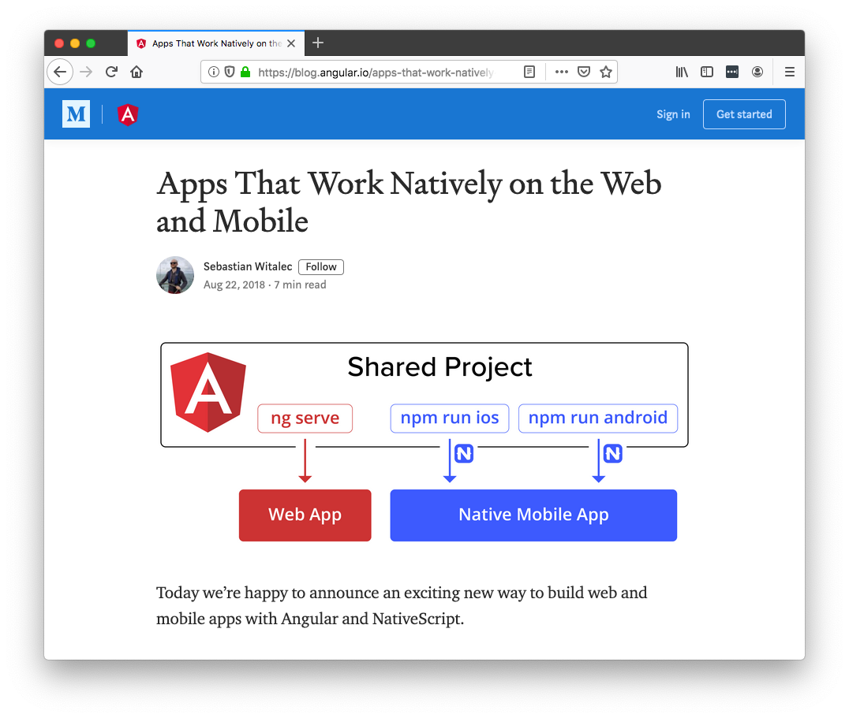

Slide 31
Code sharing resources
Introduction
https://www.nativescript.org/nativescript-is-how-you-build-native-mobile-apps-with-angular/code-sharing-angular-and-nativescript
Documentation
https://docs.nativescript.org/angular/code-sharing/intro
Sample
https://github.com/ignaciofuentes/nativescript-acme-sample/

Slide 32
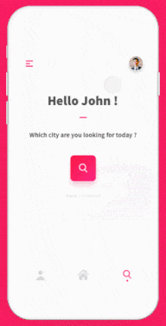
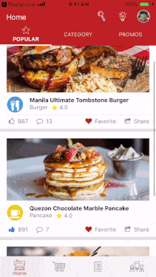
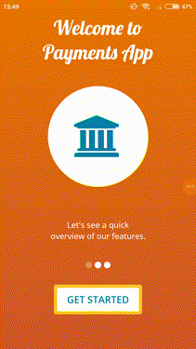
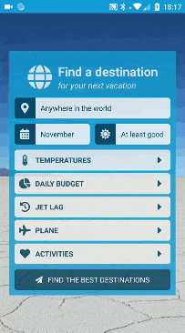
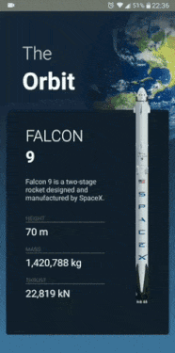
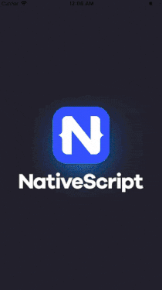
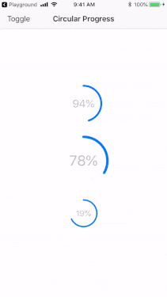
#4: Animations

Slide 33
Animations resources
Documentation
https://docs.nativescript.org/ui/animation
https://docs.nativescript.org/ui/components/frame
Lottie plugin
https://github.com/bradmartin/nativescript-lottie
Code samples
https://market.nativescript.org/?tab=samples&framework=all_frameworks&category=all_samples

Slide 34
Agenda
Pragmatic
Biometric Auth, Maps & Geolocation, Code Sharing, Animations
Useful
AppSync, Bluetooth, Wearables, Native API access
Fun
Machine Learning, AR

Slide 35
Agenda
Pragmatic
Biometric Auth, Maps & Geolocation, Code Sharing, Animations
Useful
AppSync, Bluetooth, Wearables, Native API access
Fun
Machine Learning, AR

Slide 36


#5: AppSync
Notes:
Show HMR in action

Slide 37



Slide 38
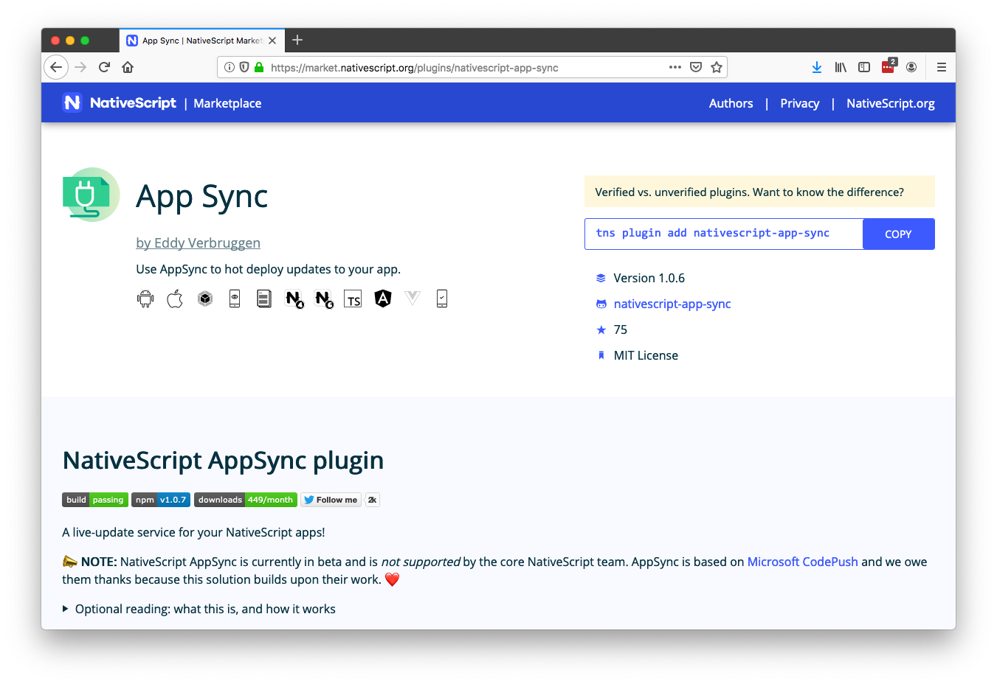
Notes:
```
nativescript-app-sync release Top10iOS ios
```

Slide 39
AppSync resources
Plugin:
https://market.nativescript.org/plugins/nativescript-app-sync
Article:
https://www.nativescript.org/blog/enable-live-updates-of-your-ios-and-android-apps-using-nativescript-appsync

Slide 40

#6: Bluetooth

Slide 41
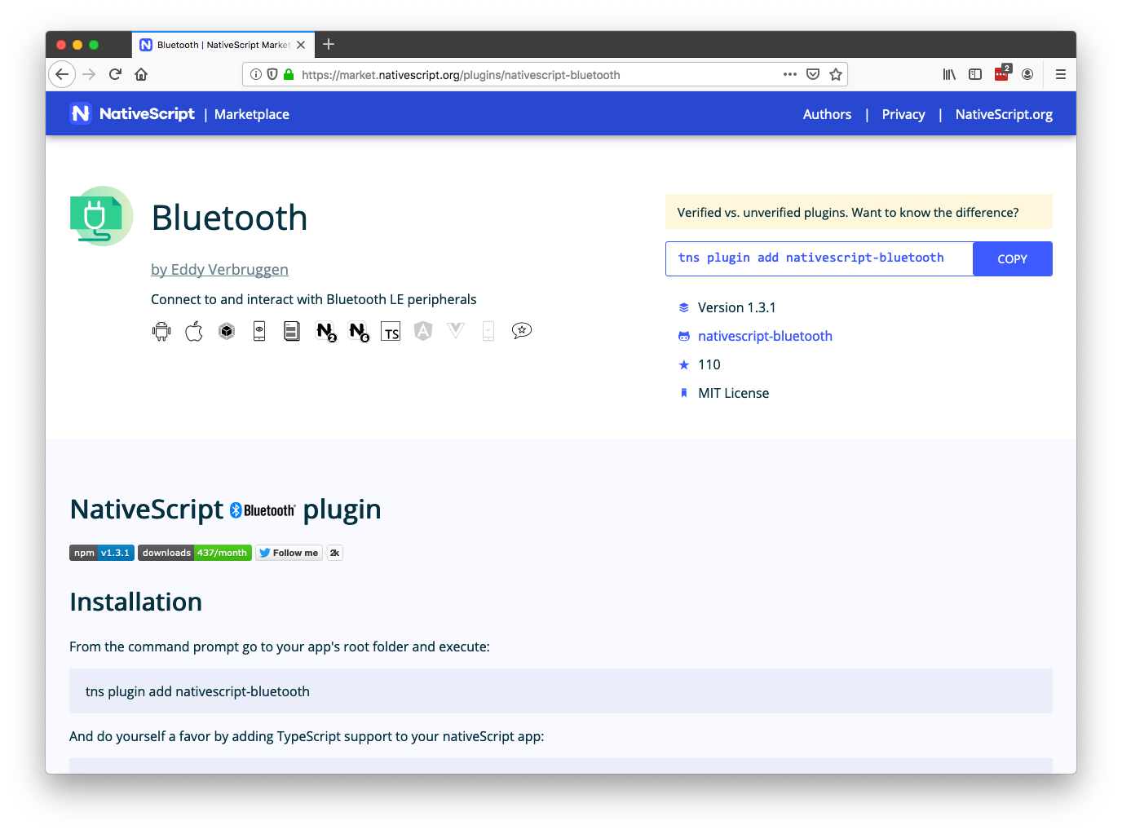

Slide 42
Bluetooth resources
Plugin
https://market.nativescript.org/plugins/nativescript-bluetooth
Article
https://www.nativescript.org/blog/controlling-robots-with-nativescript-bluetooth
Talk
https://www.youtube.com/watch?v=gRw0EMtpxlM

Slide 43
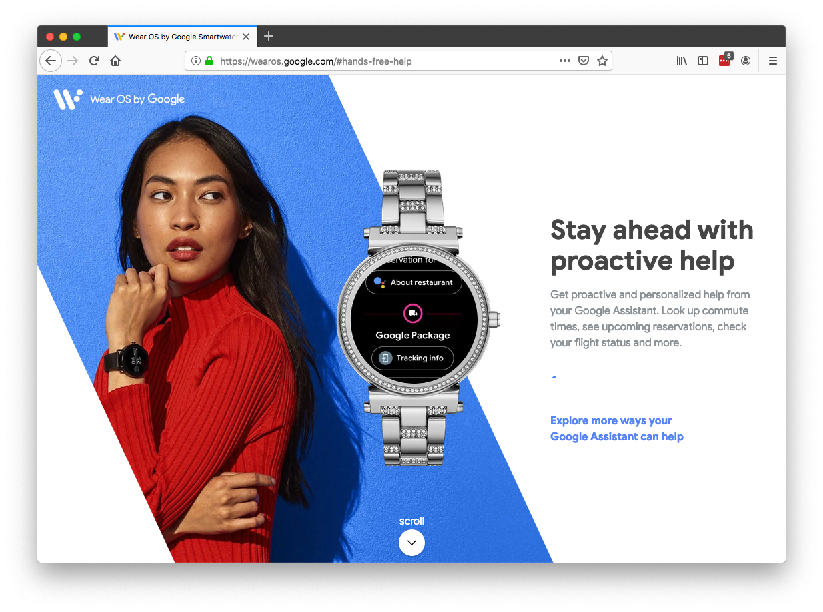
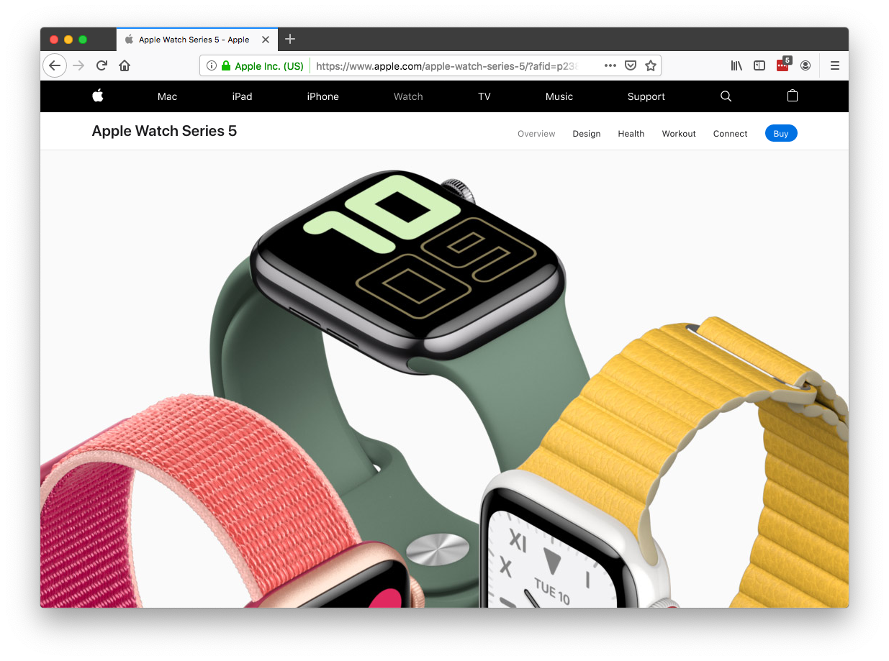
#7: Wearables

Slide 44
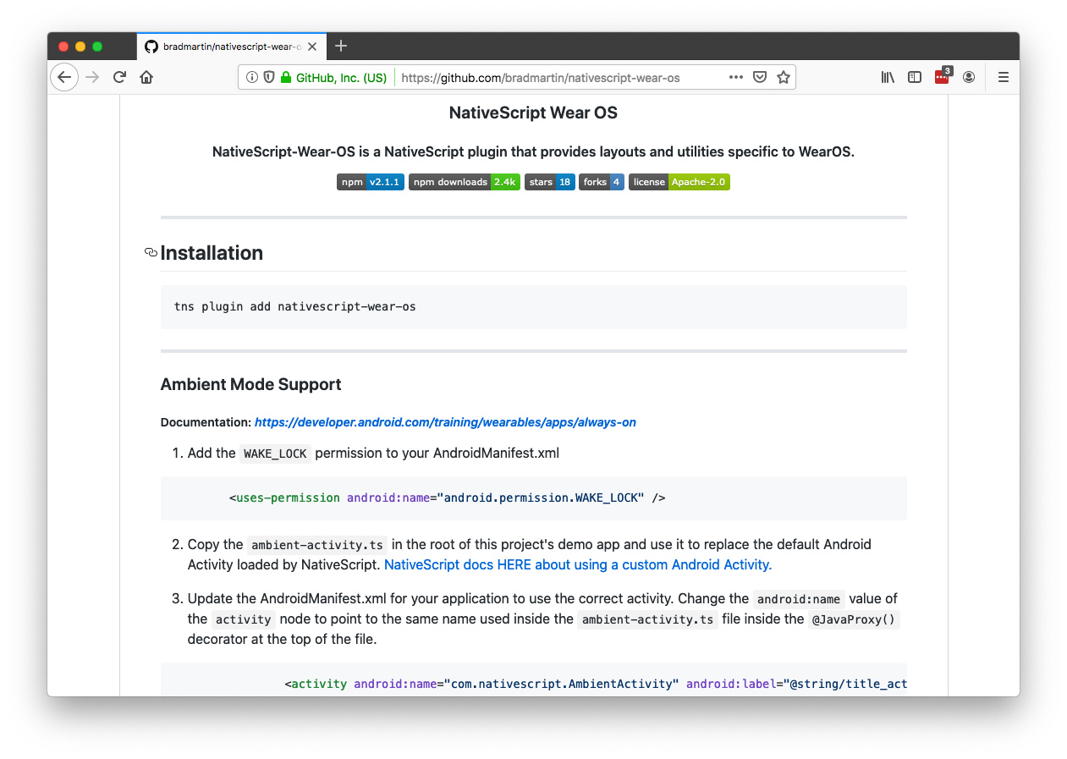

Slide 45
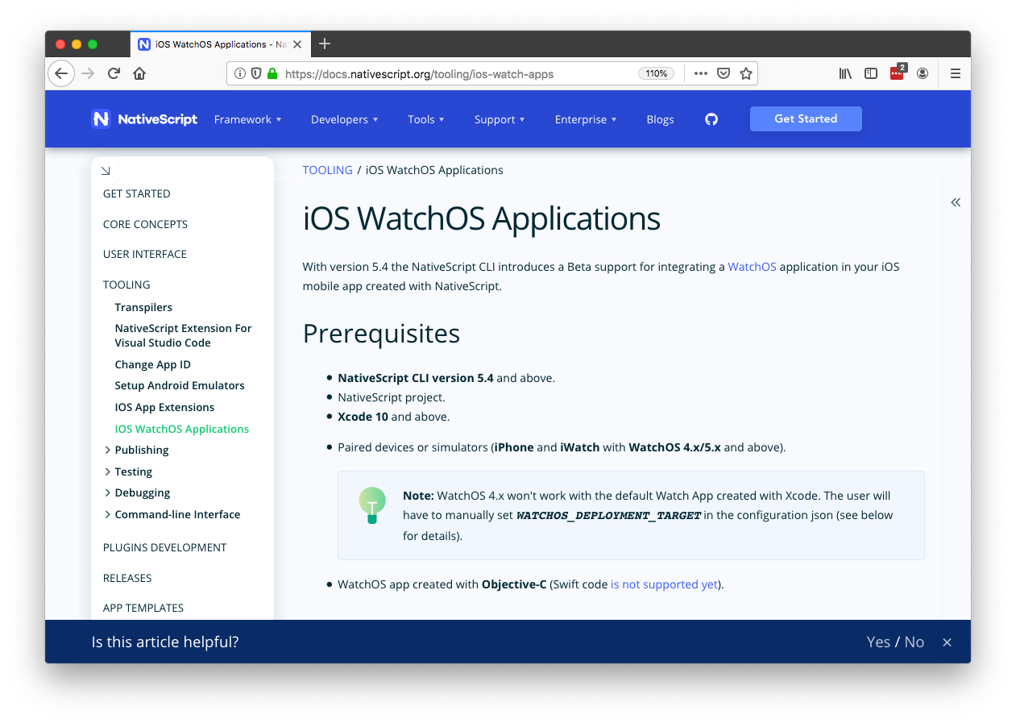

Slide 46
Resources
Wear OS plugin
https://market.nativescript.org/plugins/nativescript-wear-os
Apple Watch article
https://www.nativescript.org/blog/developing-a-watchos-extension-for-your-nativescript-app
Apple Watch documentation
https://docs.nativescript.org/tooling/ios-watch-apps

Slide 47
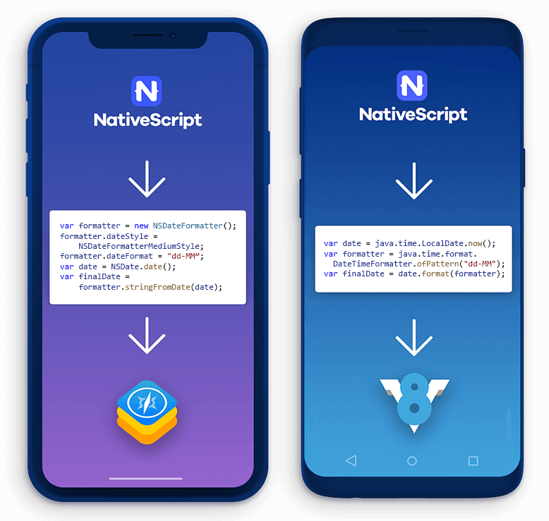
#8: Native API access

Slide 48
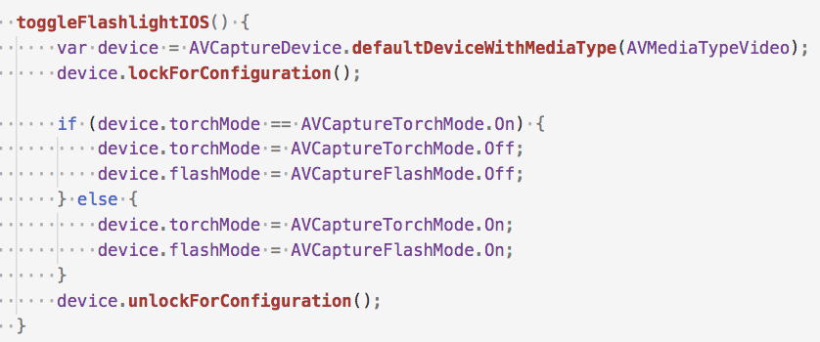

Slide 49
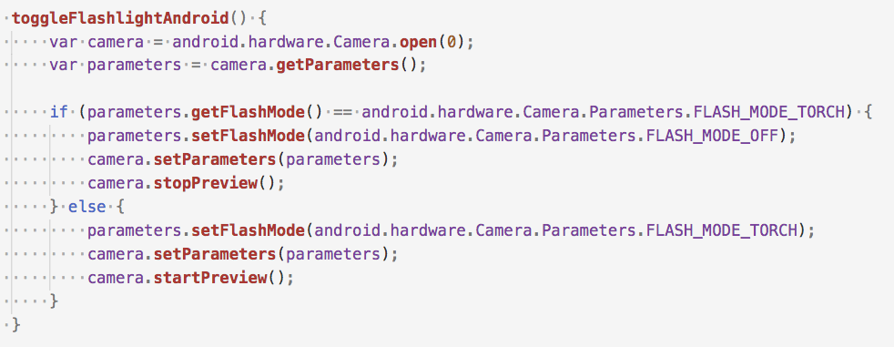

Slide 51
Resources
Documentation
https://docs.nativescript.org/core-concepts/accessing-native-apis-with-javascript
Video
https://www.youtube.com/watch?v=DGCUcqejsVk

Slide 52
Agenda
Pragmatic
Biometric Auth, Maps & Geolocation, Code Sharing, Animations
Useful
AppSync, Bluetooth, Wearables, Native API access
Fun
Machine Learning, AR

Slide 53
Agenda
Pragmatic
Biometric Auth, Maps & Geolocation, Code Sharing, Animations
Useful
AppSync, Bluetooth, Wearables, Native API access
Fun
Machine Learning, AR

Slide 54
#9: Machine learning
🤖

Slide 55


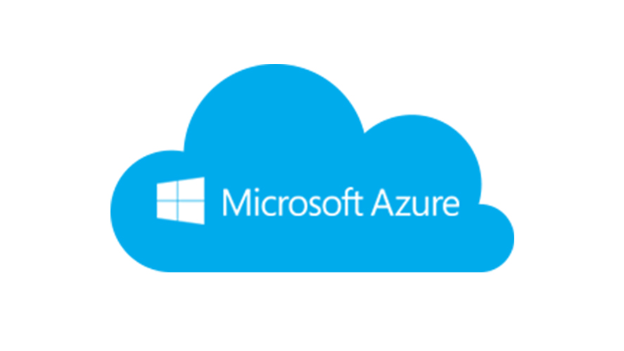


Slide 57
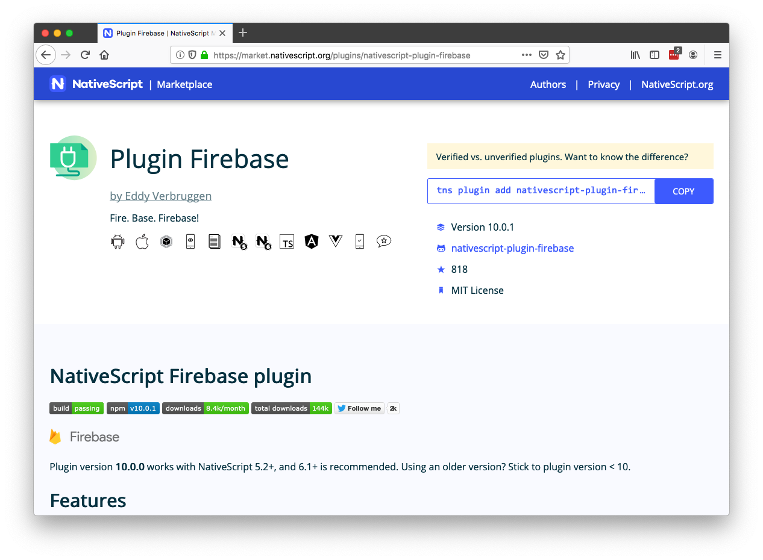

Slide 58
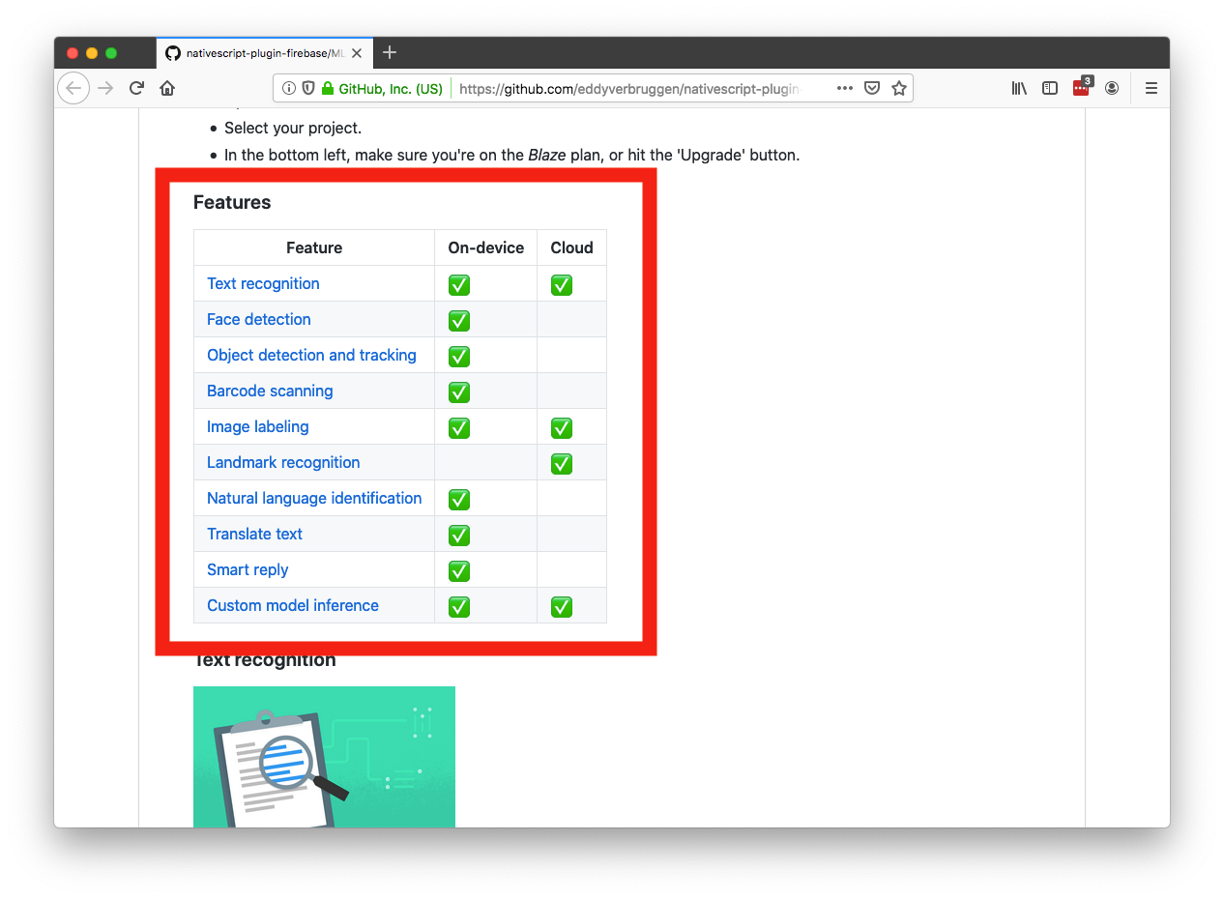

Slide 59
Machine learning resources
Plugin
https://github.com/EddyVerbruggen/nativescript-plugin-firebase
Talk
https://www.youtube.com/watch?v=dONJ2fj6iqc

Slide 60
#10: AR

Slide 61
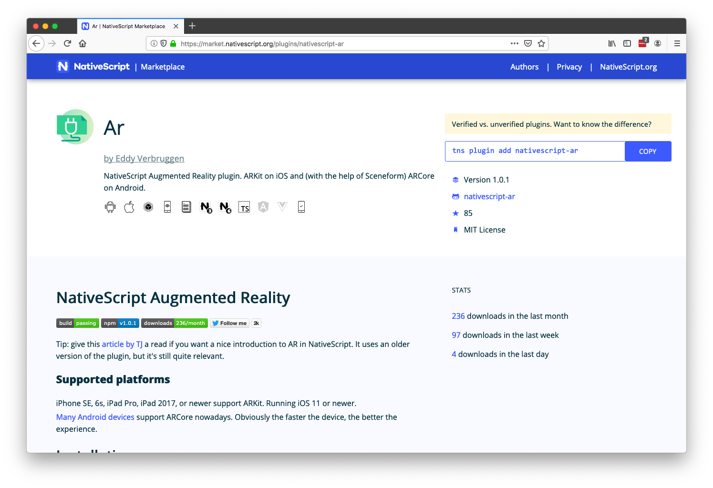

Slide 62
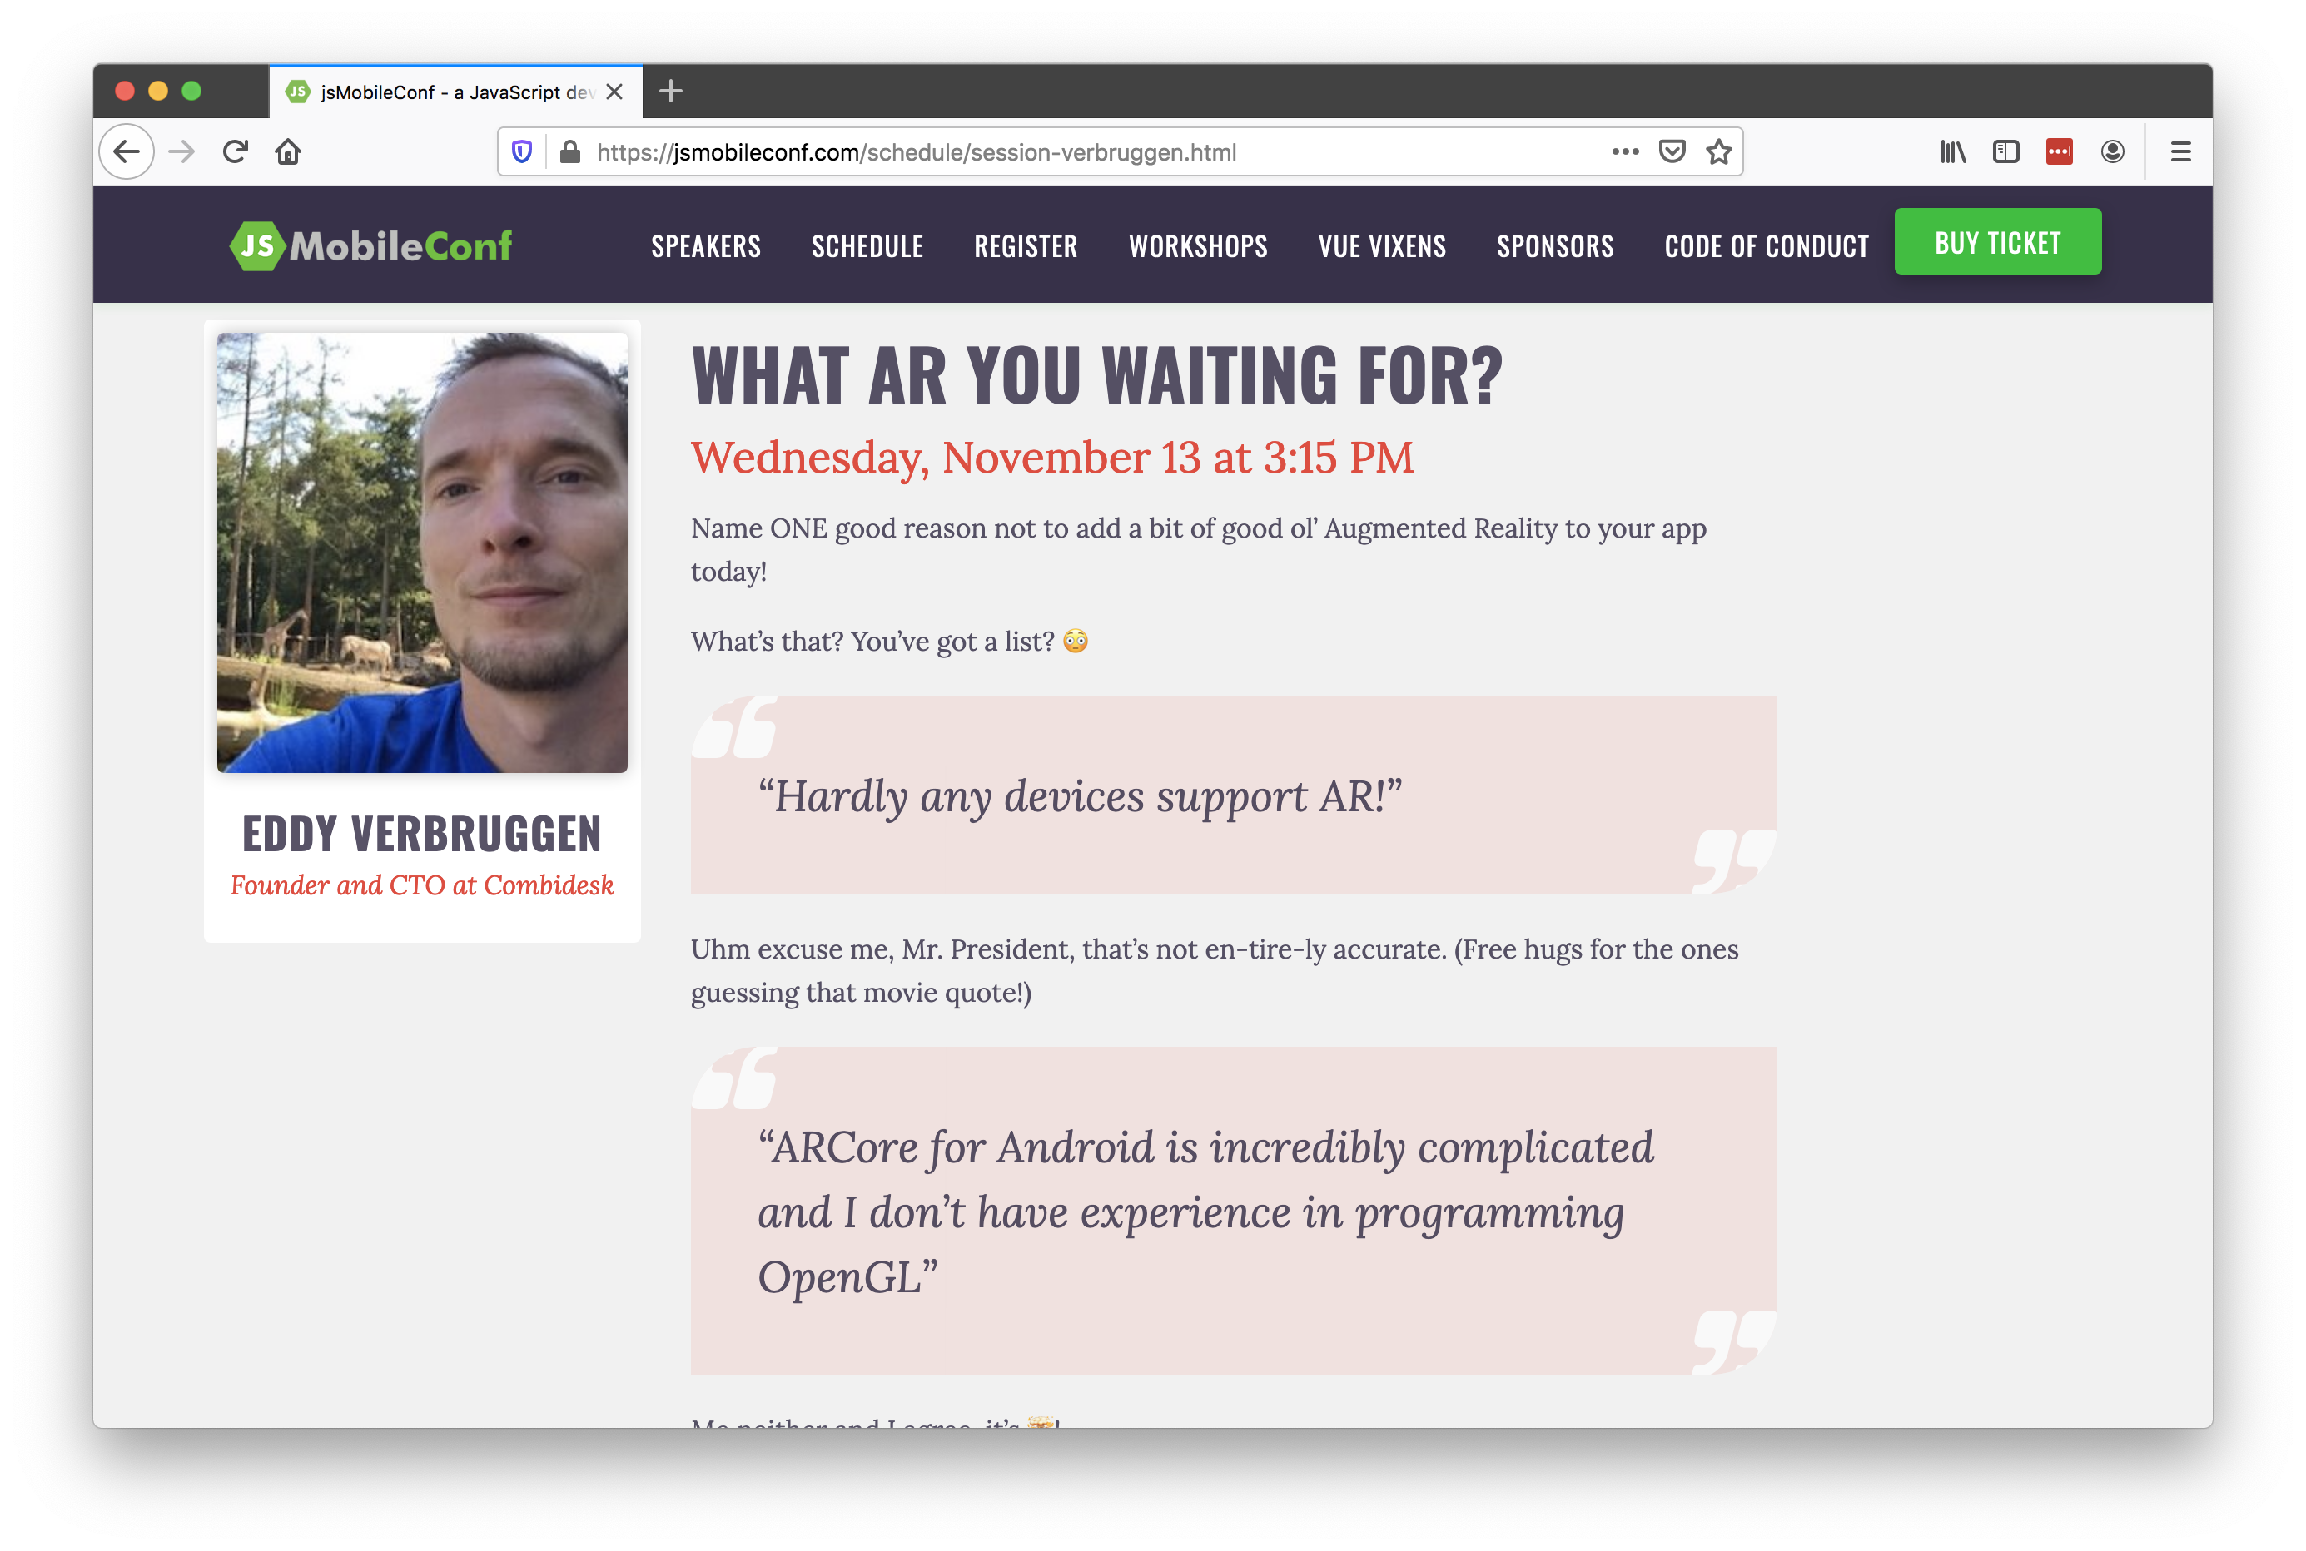

Slide 63
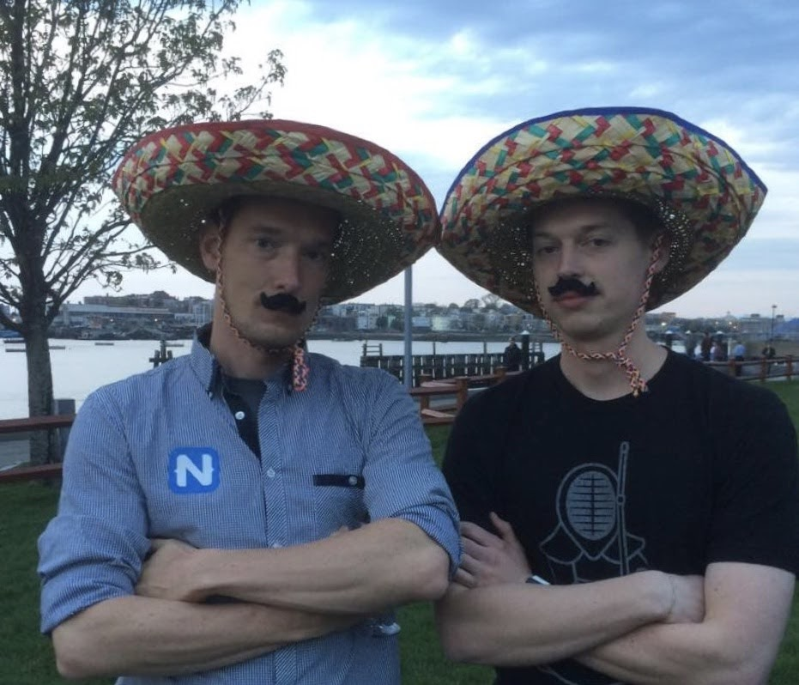
You are awesome and you will cover it too well.
TJ, don’t steal my topic.
OK

Slide 64
But at least let me tease it.
Ugh, fine. Show a few demos.

Slide 65
Augmented reality resources
Plugin
https://market.nativescript.org/plugins/nativescript-ar
Article
https://www.nativescript.org/blog/getting-started-with-augmented-reality-in-nativescript
Talk
https://www.youtube.com/watch?v=8Aw3aJDEYPI

Slide 66
Agenda
Pragmatic
Biometric Auth, Maps & Geolocation, Code Sharing, Animations
Useful
AppSync, Bluetooth, Wearables, Native API access
Fun
Machine Learning, AR

Slide 67
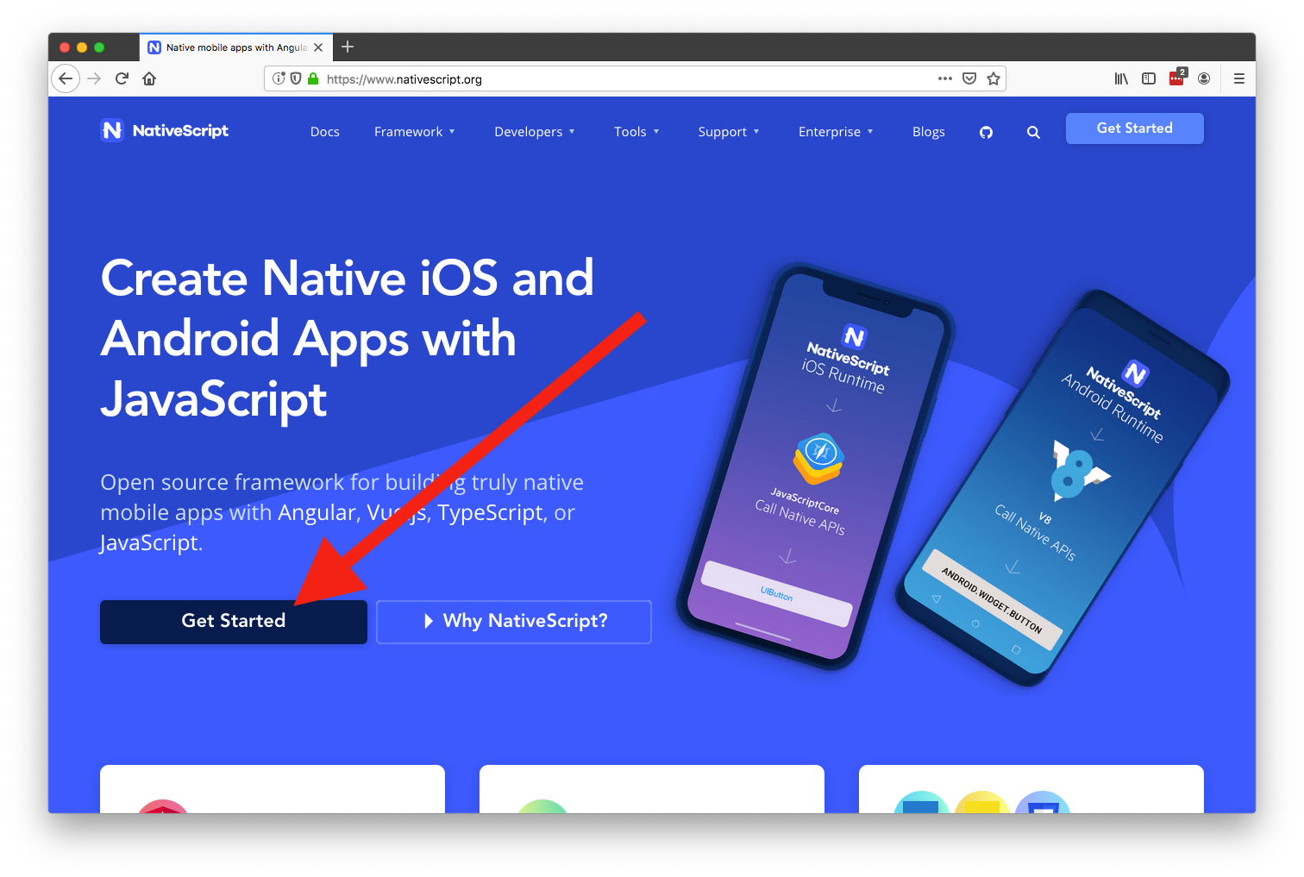

Slide 68
Thanks!
@tjvantoll
Slides: https://bit.ly/top10-slides
Demo: https://bit.ly/top10-demo
Notes:
Feel free to swap out the Progress logo with your own logo.

